Slide 1
Functions 1

Slide 2
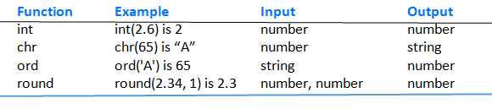
Built-in Functions
Like miniature programs
Receive input
Process the input
Have output
Table 4.1 Some Python built-in functions.

Slide 3
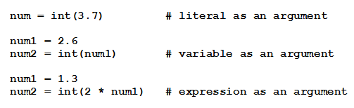
Built-in Functions
Output of functions is a single value
Function is said to return its output
Items inside parentheses called arguments
Examples:

Slide 4

User-defined Functions
Defined by statements of the form
par1, par2 are variables (called parameters)
Expression evaluates to a literal of any type
Header must end with colon
Each statement in block indented same

Slide 5
User-defined Functions
Passing parameters
We consider here pass by position
Arguments in calling statement matched to the parameters in function header based on order
Parameters and return statements optional in function definitions
Function names should describe the role performed

Slide 6
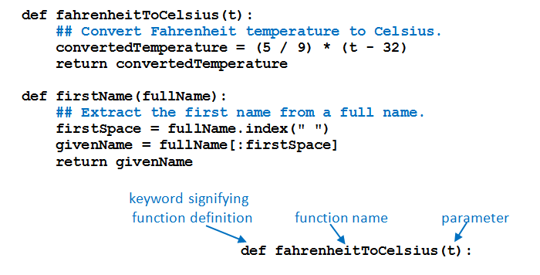
Functions Having One Parameter
FIGURE 4.1 Header of the fahrenheitToCelsius function

Slide 7
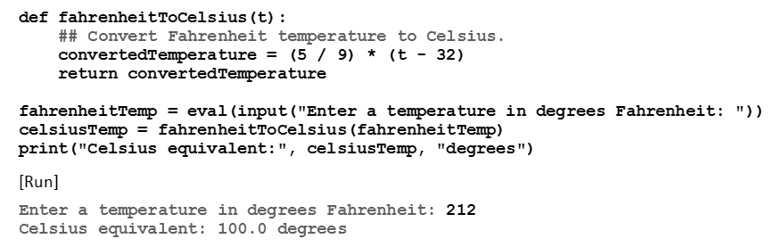
Functions Having One Parameter
Example 1: Program uses the function fahrenheitToCelsius

Slide 8
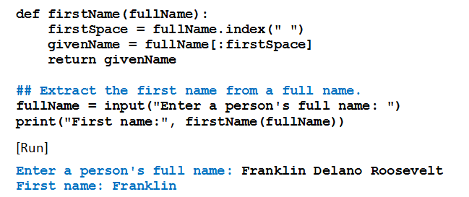
Functions Having One Parameter
Example 2: Program uses the function firstName

Slide 9
Passing a Value to a Function
If the argument in a function call is a variable
Object pointed to by the argument variable (not the argument variable itself) passed to a parameter variable
Object is immutable, there is no possibility that value of the argument variable will be changed by a function call

Slide 10
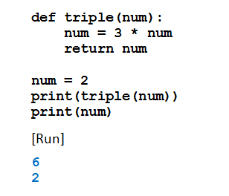
Passing a Value to a Function
Example 3: Program shows there is no change in the value of the argument

Slide 11
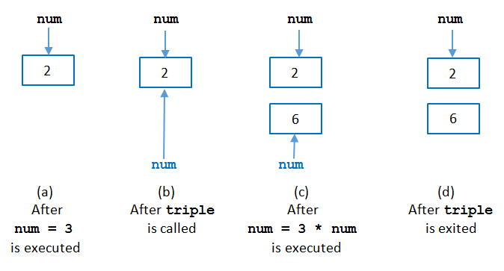
Passing a Value to a Function
FIGURE 4.2 Passing a value to a function.

Slide 12
Functions Having Several Parameters
Must be the same number of arguments as parameters in the function
Data types of arguments’ values must be compatible with data types expected by the parameters
Must also be in the same order

Slide 13
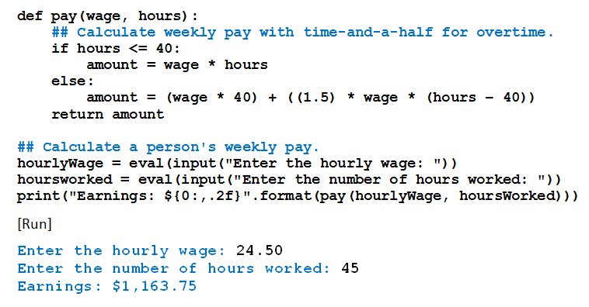
Functions Having Several Parameters
Example 4: Program uses the function pay.

Slide 14
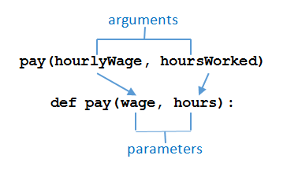
Functions Having Several Parameters
FIGURE 4.3 Passing arguments to a function.

Slide 15
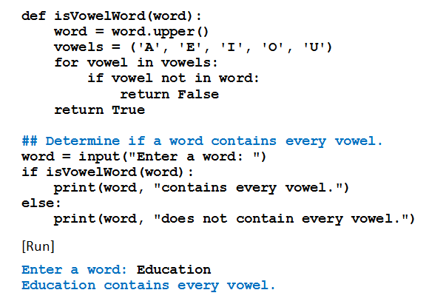
Boolean- and List-valued Functions
Example 6: Program uses a Boolean-valued function to determine whether input is a vowel word

Slide 16
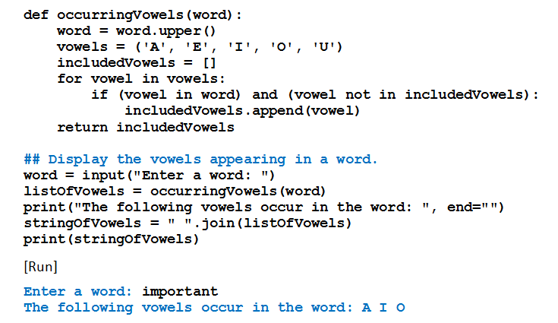
Boolean- and List-valued Functions
Example 7: Program uses a list-valued function

Slide 17
Scope of Variables
Variable created inside a function can only be accessed by statements inside that function
Ceases to exist when the function is exited
Variable is said to be local to function or to have local scope
If variables created in two different functions have the same name
They have no relationship to each other

Slide 18
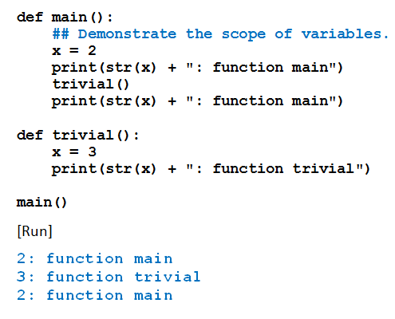
Scope of Variables
Example 10: Variable x in the function main, variable x in the function trivial are different variables

Slide 19
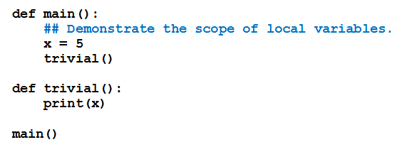
Scope of Variables
Example 11: Variable x created in function main not recognized by function trivial.

Slide 20

Scope of Variables
Scope of a variable is the portion of the program that can refer to it
To make a variable global, place assignment statement that creates it at top of program.
Any function can read the value of a global variable
Value cannot be altered inside a function unless

Slide 21
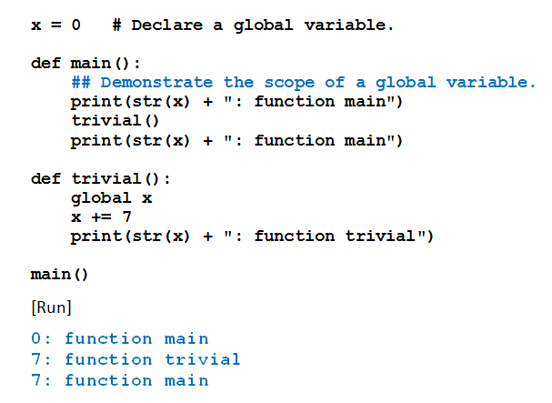
Scope of Variables
Example 12: Program contains a global variable

Slide 22
Named Constants
Program sometimes employs a special constant used several times in program
Convention programmers use
Create a global variable
Name written in uppercase letters with words separated by underscore
In Python, programmer is responsible for not changing value of the variable

Slide 23
Library Modules
A library module is a file with extension .py
Contains functions and variables
Can be used (imported) by any program
can be created in IDLE or any text editor
Looks like an ordinary Python program
To gain access to the functions and variables
place a statement of the form import moduleName at the beginning of the program

Slide 24
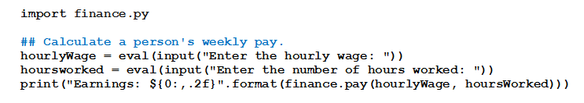
Library Modules
Consider a file with pay and futureValue functions
Save as finance.py in same folder as examples 4 and 6
Rewrite example 4 as

Slide 25
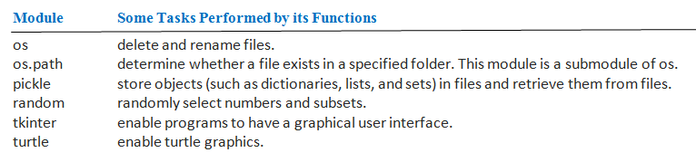
Library Modules
Table 4.2 Several modules from the standard library.

Slide 26
END

